Slide 1
Implementation of EU policies in Water Resources Management – Lessons Learnt in Bulgaria
Assoc. Prof. Dr. Eng. Petar Filkov
University of Architecture, Civil Engineering and Geodesy, Sofia, Bulgaria
Theme-based Staff Training in UACEG
Reflection of the water policies in the education: insights form the Bulgarian experience
Sofia/ 29-31.05.2019
This project has been funded with support from the European Commission. This publication reflects the views only of the author, and the Commission cannot be held responsible for any use which may be made of the information contained therein.

Slide 2
Contents
Water Framework Directive
Floods Directive
Drinking Water Directive
Groundwater Directive
Urban Waste-Water Treatment Directive
Bird Directive and the Habitat Directive
UN Sustainable Development Framework
EU Action Plan for the Circular Economy
Strengthening of master curricula in water resources management
for the Western Balkans HEIs and stakeholders

Slide 3
1. Water Framework Directive
Harmonization – through Bulgarian Water Act
Water management policy
at national level
Ministry of Environment and Water,
assisted by Directorate Water Management.
at local (basin) level
4 River Basin Directorates
and 16 Regional Inspectorates of Environment and Water (monitor and control waste waters)
Strengthening of master curricula in water resources management
for the Western Balkans HEIs and stakeholders

Slide 4
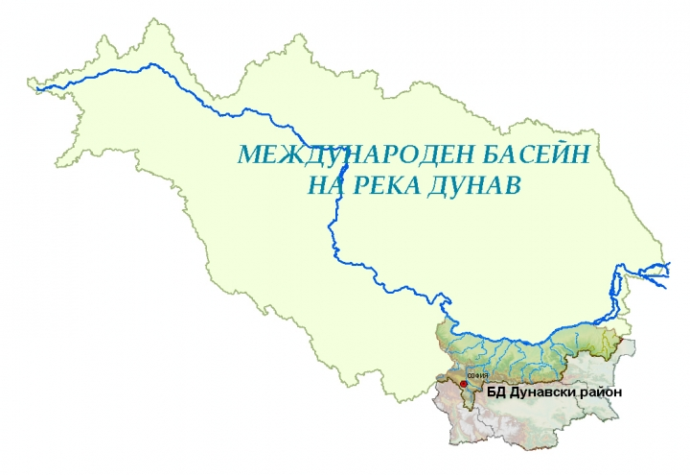
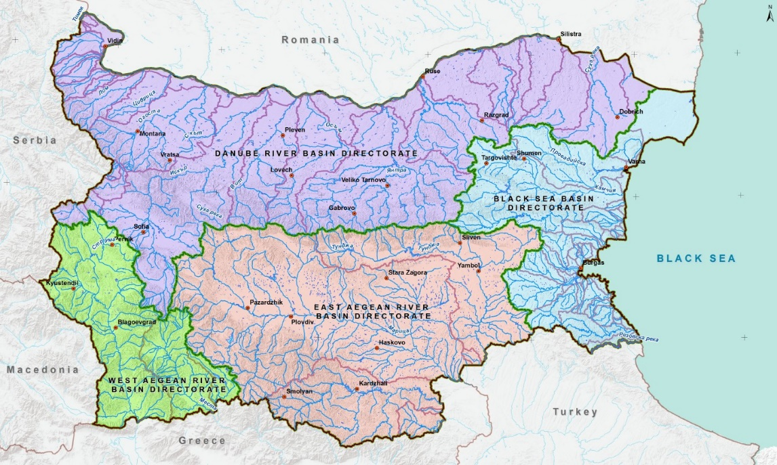
1. Water Framework Directive
River Basin Directorates in Bulgaria
Strengthening of master curricula in water resources management
for the Western Balkans HEIs and stakeholders

Slide 5
1. Water Framework Directive
River Basin Management Plans (RBMPs)
First Plans – for the period 2010-2015
Programmes of Measures are developed together with each RBMP.
All RBMPs and respective Programmes of Measures were adopted after public discussions.
Second Plans – (current) period 2016-2021
Already started preparations for the next period 2022-2027
Strengthening of master curricula in water resources management
for the Western Balkans HEIs and stakeholders

Slide 6
2. Floods Directive
Harmonization – through Bulgarian Water Act (2010)
First Plans – for the period 2016-2021
Preliminary flood risk assessment was undertaken in all 4 RBDs, on the basis of common methodology.
The regions with a significant potential flood risk were established on a basis of common criteria for all 4 RBDs.
Maps of floods hazard and flood risk were developed
Flood Risk Management Plans 2016-2021 were prepared by RBDs.
Strengthening of master curricula in water resources management
for the Western Balkans HEIs and stakeholders

Slide 7
2. Floods Directive
First Plans – for the period 2016-2021
A national catalogue of measures was adopted, based on a methodology for cost and benefit analysis of measures.
All 4 Flood Risk management Plans were adopted by Bulgarian Government
Stakeholders – Napoitelni Sistemi JSC, Dams and Cascades Enterprise, Municipalities
The control is done by
General Directorate of Fire Safety and Civil Protection (Ministry of Interior),
Representatives of RBDs and Municipalities
Strengthening of master curricula in water resources management
for the Western Balkans HEIs and stakeholders

Slide 8
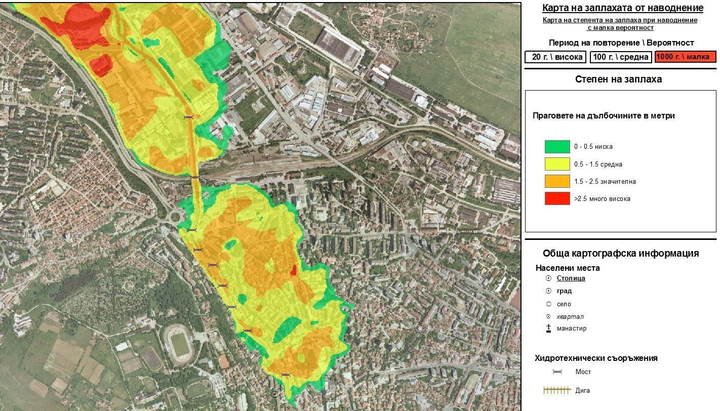
2. Floods Directive
Flood Hazard Map – city of Pleven, p = 0,1%; water depth thresholds
Strengthening of master curricula in water resources management
for the Western Balkans HEIs and stakeholders

Slide 9
3. Drinking Water Directive
Harmonization
Bulgarian Water Act (2010)
Act for Regulation of Water Supply and Sanitation Services (2005 and following amendments)
Ordinance Nr 9 / 16.03.2001 for quality of water intended for human consumption, (Minister of Health, Minister of Regional Development and Public Works and Minister of Environment and Water)
Ordinance Nr 12 / 18.06.2002 for quality requirements for surface waters intended for drinking water supply.
Strengthening of master curricula in water resources management
for the Western Balkans HEIs and stakeholders

Slide 10
3. Drinking Water Directive
Harmonization
The general public is informed about the drinking water quality by the annual Reports on Drinking Water Quality issued by each of 4 River Basin Directorates.
Quality
Water supply systems abstraction consists of
51% surface water and
49% ground water.
Strengthening of master curricula in water resources management
for the Western Balkans HEIs and stakeholders

Slide 11
3. Drinking Water Directive
Quality
Bulgaria is the only new EU member state that scored compliance levels of 95-100% for all three types of parameters (microbiological, chemical and indicators).
At the national level water quality is very good.
There are specific issues in some small water supply zones
The average compliance rates of water samples is:
99.6% in big water supply zones.
98.4% in small zones (on national level)
Strengthening of master curricula in water resources management
for the Western Balkans HEIs and stakeholders

Slide 12
4. Groundwater Directive
Harmonization
through amendments in Water Act.
Ordinance Nr 2 from 13.09.2007 about prevention of waters from contamination with nitrates from agricultural origins;
Ordinance Nr 1 from 10.10.2007 for exploration, use and protection of groundwater.
Water abstraction permits are issued by respective River Basin Directorate, according to available recourse.
The water recourses of the groundwater bodies - determined via common methodology, issued by MoEW
Strengthening of master curricula in water resources management
for the Western Balkans HEIs and stakeholders

Slide 13
5. Urban Wastewater Treatment Directive
Harmonization
through amendments in Water Act.
amendments in other documents
Ordinance Nr. РД-02-20-8 / 17.05.2013 on design, construction and exploitation of sewerage systems;
Ordinance Nr 6 / 9.11.2000 on emission standards for the permissible content of harmful and dangerous substances in wastewater discharged into water bodies;
Ordinance Nr 7 / 14.11.2000 on the conditions and order for discharge of industrial waste-water into the urban sewerage systems
Strengthening of master curricula in water resources management
for the Western Balkans HEIs and stakeholders

Slide 14
5. Urban Wastewater Treatment Directive
Current state
66% of the population is connected to urban wastewater collection
50% is connected to an urban wastewater treatment plant
Serious issue to meet EU requirements
slow construction of new WWTP and new sewerage networks
settlements between 2,000 and 10,000 P.E.
Strengthening of master curricula in water resources management
for the Western Balkans HEIs and stakeholders

Slide 15
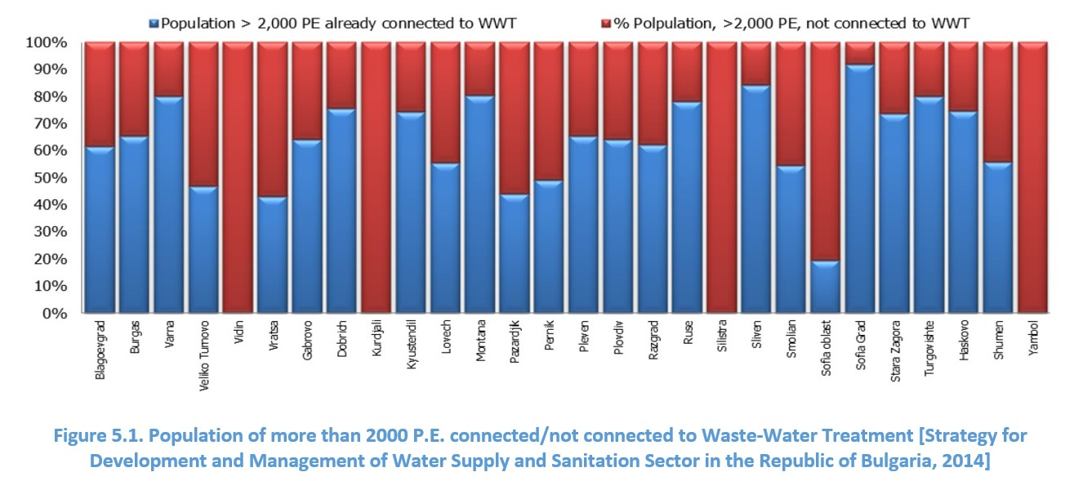
5. Urban Wastewater Treatment Directive
Percentage of population connected to wastewater collection (settlements more than 2,000 P.E.)
Percentage of population connected to wastewater treatment (settlements more than 2,000 P.E.)
Source: Strategy for Development and Management of Water Supply and Sanitation Sector in the Republic of Bulgaria, 2014
Strengthening of master curricula in water resources management
for the Western Balkans HEIs and stakeholders

Slide 16
6. Bird Directive and the Habitat Directive
Harmonization
Environment Protection Act (from 2002 and following amendments),
Bio Diversity Act (2002 and following amendments)
Ordinance on the conditions and order for development and approval of plans for management of protected areas (2008).
Strengthening of master curricula in water resources management
for the Western Balkans HEIs and stakeholders

Slide 17
6. Bird Directive and the Habitat Directive
Ecological Network in Bulgaria
119 protected zones under Bird Directive (23.6 % of land territory and 54 km² of aquatory)
234 protected zones under Habitat Directive (30% of land territory).
There is partial overlap of two zones
Total area of two types of zones - 34.5% of the state territory
Strengthening of master curricula in water resources management
for the Western Balkans HEIs and stakeholders

Slide 18
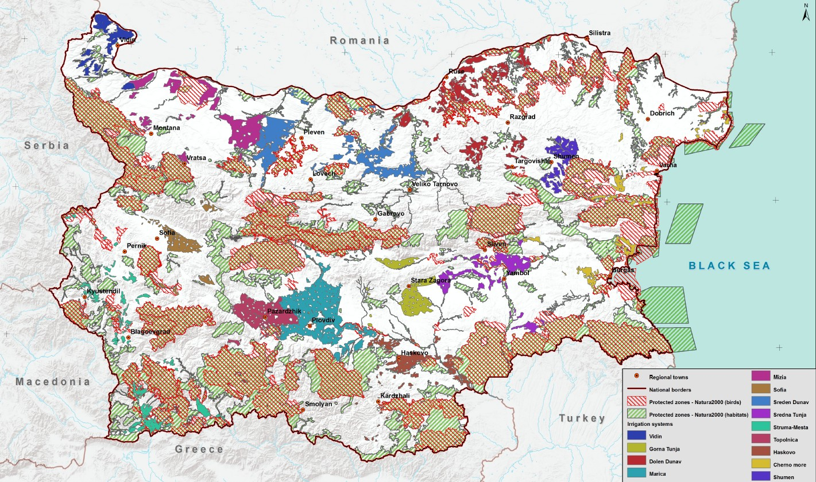
6. Bird Directive and the Habitat Directive
Irrigation Systems in Bulgaria
Natura 2000 (Habitats)
Natura 2000 (Birds)
Strengthening of master curricula in water resources management
for the Western Balkans HEIs and stakeholders

Slide 19
7. Issues and Lessons Learnt
1. Too many ministries involved
Ministry of Environment and Water
River Basin Directorates
Ministry of Agriculture, Food and Forests.
Napoitelni Sistemi JSC (Irrgation Systems JSC)
irrigation systems management
flood risk management in rural areas
protection against harmful effects of water (drainage of agricultural lands).
Ministry of Energy (through National Electric Company)
Dams and Cascades Enterprise
Hydroelectric Power Plants Enterprise
Strengthening of master curricula in water resources management
for the Western Balkans HEIs and stakeholders

Slide 20
7. Issues and Lessons Learnt
7.1. Too many ministries involved
Ministry of Interior
Directorate General of Fire Safety and Civil Protection
Ministry of Economy
State agency for metrological and technical surveillance
DG Supervision of dams and related facilities
State Enterprise for management and maintenance of Dams
Ministry of Regional Development and Public Works
Water Supply and Sanitation (Sewerage) companies
Ministry of Health.
Strengthening of master curricula in water resources management
for the Western Balkans HEIs and stakeholders

Slide 21
7. Issues and Lessons Learnt
7.2. Municipalities
Water Supply and Sanitation systems and facilities
Flood risk management in urban areas
Small dams operation and maintenance
No capacity to perform all tasks
7.3. NGOs
Environment protection
Birds and habitats
Fish
Obstructions of big water management projects
Strengthening of master curricula in water resources management
for the Western Balkans HEIs and stakeholders

Slide 22
7. Issues and Lessons Learnt
7.4. Problems
Bad communication
between ministries
between government organisations (agencies, Directorates General, State-owned companies/enterprises, etc.)
between ministries (subordinated structures) and municipalities
Different priorities of ministries
Clumsy public procurements for (re)construction of WWTP and wastewater networks.
Strengthening of master curricula in water resources management
for the Western Balkans HEIs and stakeholders

Slide 23
THANK YOU FOR YOUR ATTENTION!
Strengthening of master curricula in water resources management
for the Western Balkans HEIs and stakeholders

