Slide 1
CIRCULAR ECONOMY POLICIES FOR SUSTAINABLE DEVELOPMENT IN URBAN WATER MANAGEMENT
Prof. Irina Ribarova, PhD, Eng.
University of Architecture, Civil Engineering and Geodesy, Sofia, Bulgaria
Theme-based Staff Training in UACEG
Reflection of the water policies in the education: insights form the Bulgarian experience
Sofia/ 29-31.05.2019
This project has been funded with support from the European Commission. This publication reflects the views only of the author, and the Commission cannot be held responsible for any use which may be made of the information contained therein.

Slide 2
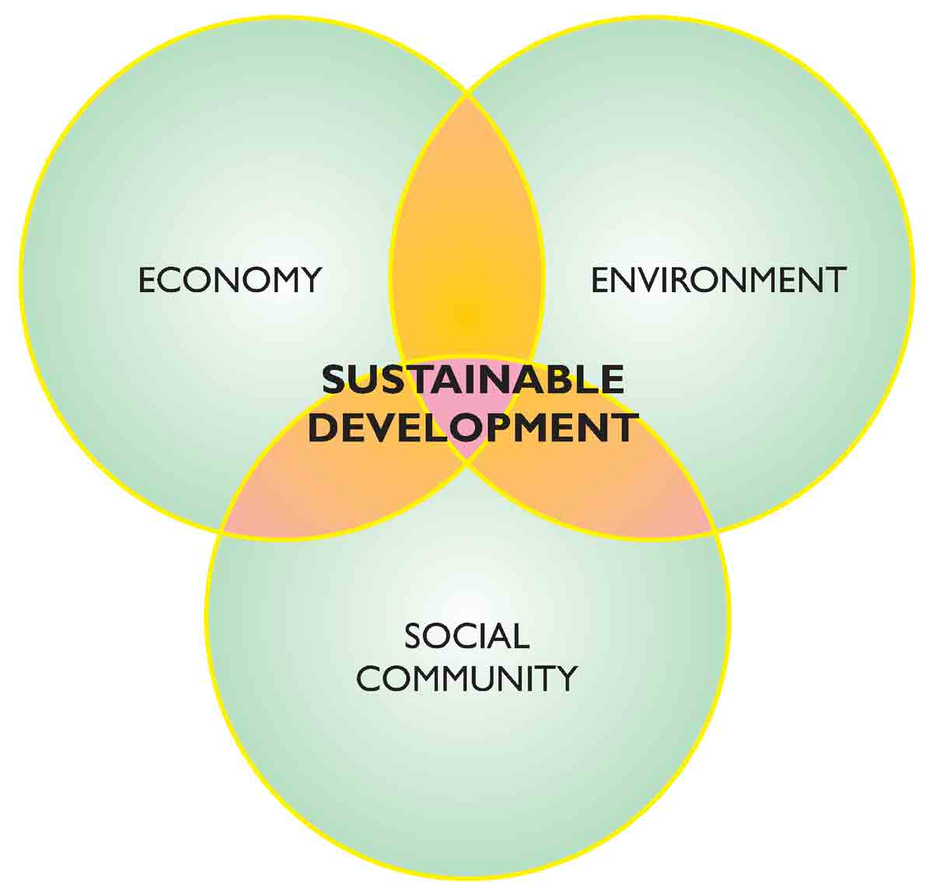
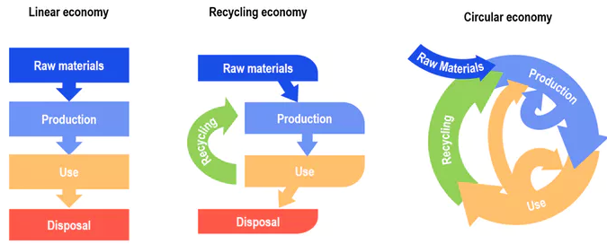
Two EU framework policies
1. Sustainable development
2. Circular economy
Source: http://www.yourarticlelibrary.com
Source: http://theconversation.com/the-planned-national-waste-policy-wont-deliver-a-truly-circular-economy-103908
McDonough, Michael Braungart, 2002. Cradle to cradle

Slide 3
Reflection on urban water management policies in the EU
Supply potable water
Take wastewater away
Efficient water use
Wastewater treatment prior discharge
Water-energy nexus
More stringent wastewater treatment
?
Circular economy
Sustainable development
Water-energy-food nexus
Wastewater – source of valuable resources
Environmental considerations

Slide 4
The pathways towards a circular economy
B
Typical WWTP
C
Primary sedimentation
A
Mechanical treatment
Biological treatment
Secondary sedimentation
Wastewater from the community
Primary sludge
Excess sludge
A
A
Two waste streams – sludge and wastewater. Their quality is of ultimate importance for achieving a circular economy
There seem to be three ways:
Improve treatment to increase the quality of these two streams so that they can be re-used
Develop completely new treatment technology, not producing sludge
Reduce pollutants at the source, which will enable the production of “cleaner” wastewater not requiring deeper treatment

Slide 5
The pathways towards a circular economy: Path A -wastewater
Mechanical treatment
Primary sedimentation
A
Biological treatment
Secondary sedimentation
Wastewater from the community
Primary sludge
Excess sludge

Slide 6
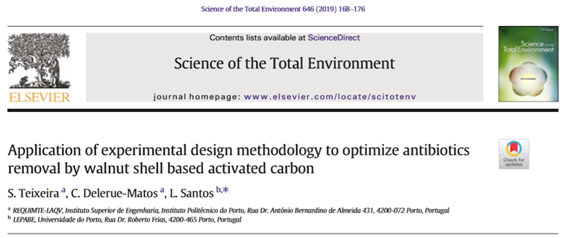
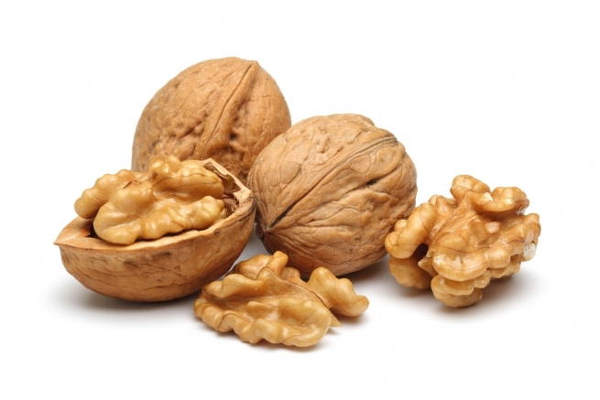
A. Some interesting new technologies for improved wastewater treatment
About 75% of the walnut production is nut shells, which are wasted.

Slide 7
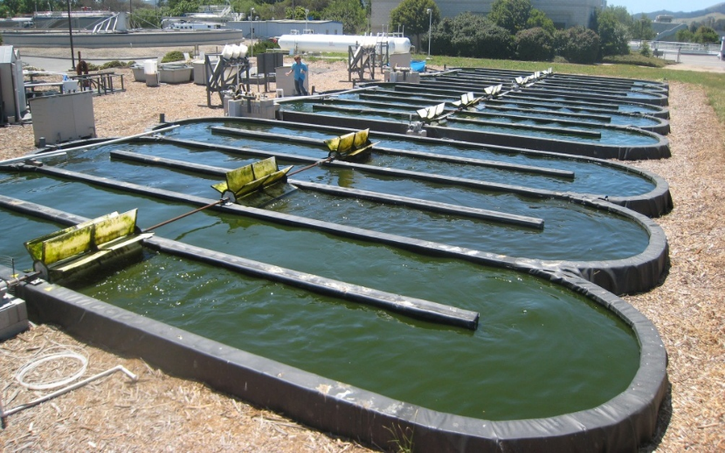
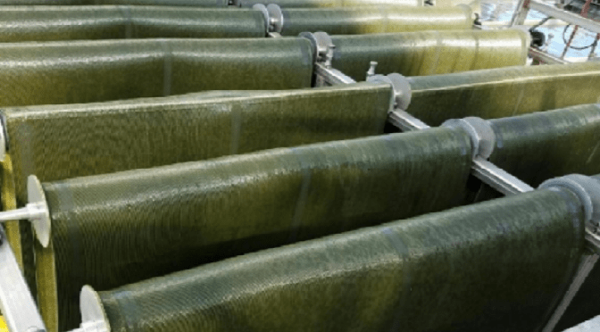
Alternative technologies for phosphorus removal: Algae-based technologies
Screen
Grid chamber
Primary clarifier
Bioreactor
Secondary clarifier
Algae post-treatment
Discharge
https://www.wef.org/resources/topics/browse-topics-a-n/algae/
http://news.algaeworld.org/2017/08/new-wastewater-treatment-system-runs-on-algae/
https://www.us.schott.com/innovation/wastewater-treatment-latest-footwear-algae-solves-problems/

Slide 8
Main challenges and opportunities of algae technologies
Challenges
Separation of the algae from the treated effluent
Contamination of the strains
Area requirements
Seasonal and daily irregularities - different treatment rate
Opportunities
Biofuel
Capture of CO2 from air
Production of oxygen
Other use

Slide 9
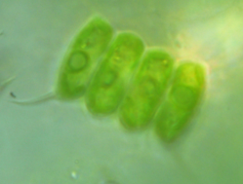
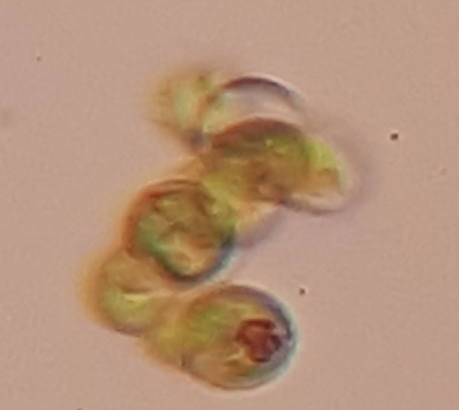
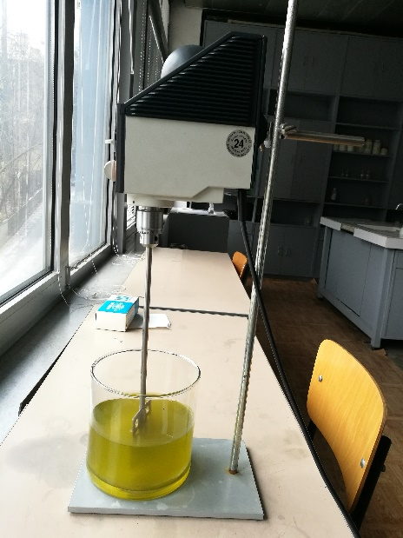
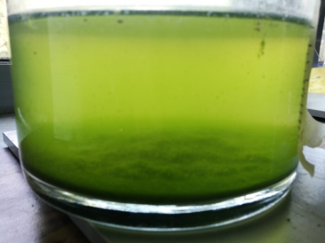
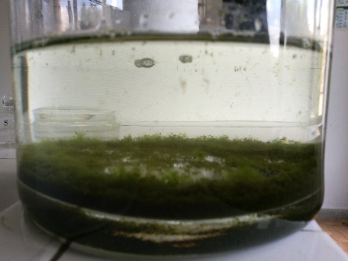
Our current research

Slide 10
The pathways towards a circular economy: Path A – plus sludge
Primary sedimentation
A
Mechanical treatment
Biological treatment
Secondary sedimentation
Wastewater from the community
Primary sludge
Excess sludge
A
A

Slide 11
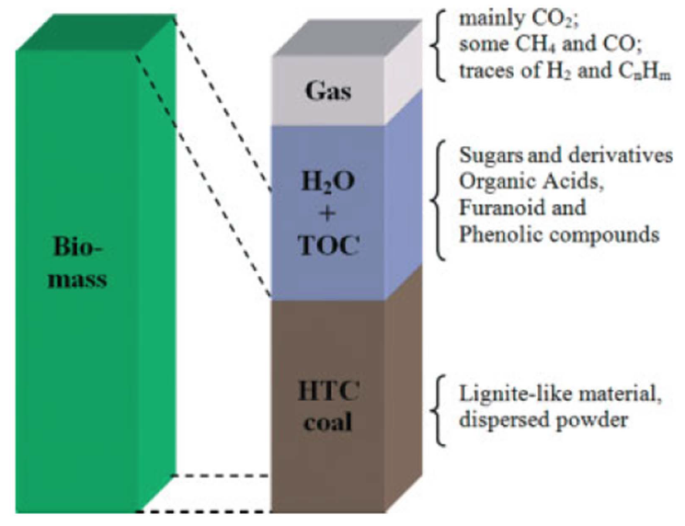
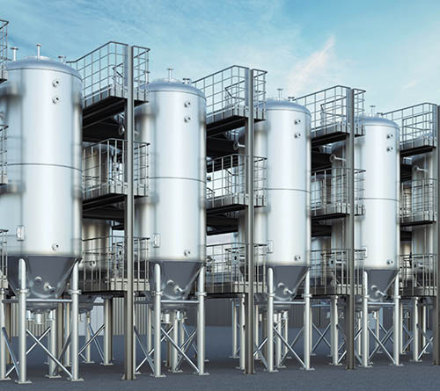
A. Some interesting new technologies for improved treatment - sludge
Hydrothermal carbonization (HTC) - high temperature and pressure on the sludge
Three main products: gas, a coal-like product (hydrochar, that serves as fuels) and water-soluble products
Later one: phosphorus might be recovered and heavy metals be separated
Source: https://htcycle.ag/en

Slide 12
The pathways towards circular economy: Path B
B
Wastewater from the community
Mechanical treatment
Primary sedimentation
Biological treatment
Secondary sedimentation
Primary sludge
Excess sludge

Slide 13
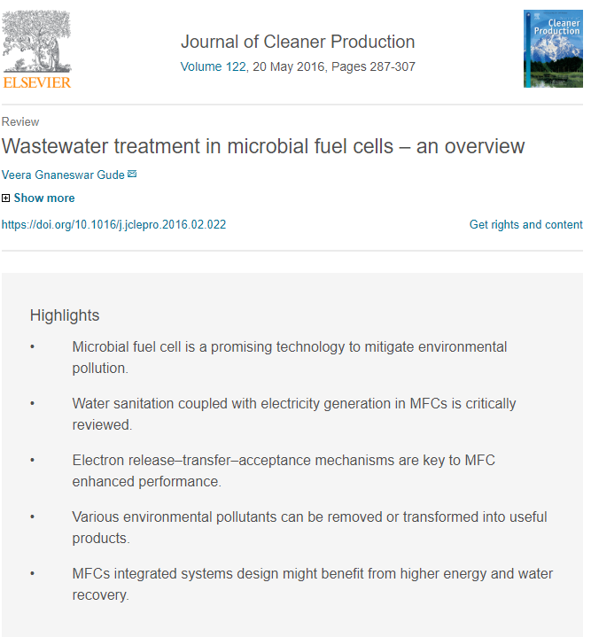
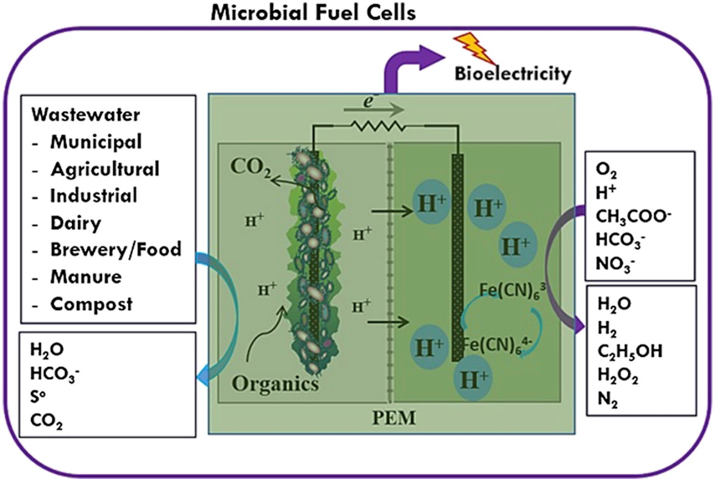
B. Microbial fuel cells

Slide 14
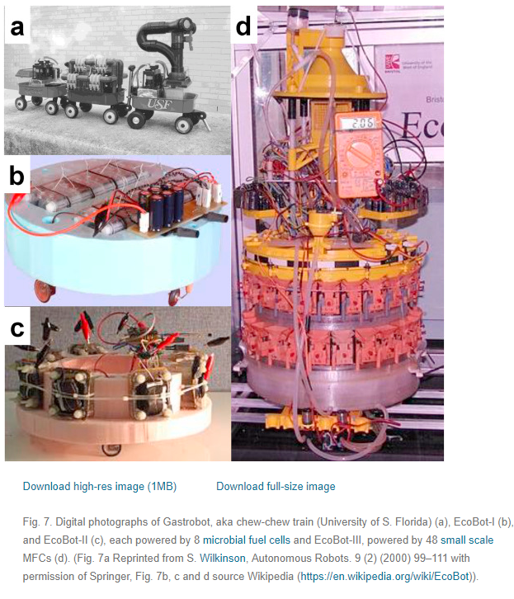
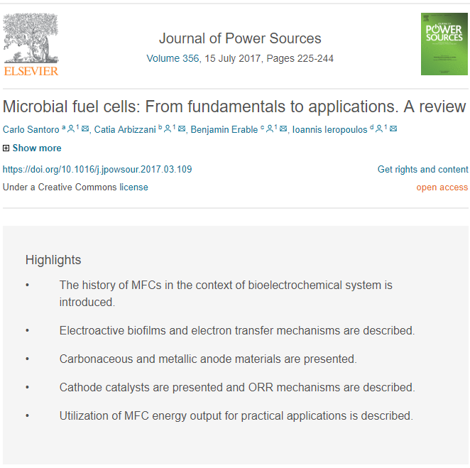
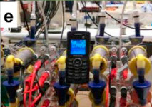
B. Completely new treatment technologies not producing sludge

Slide 15
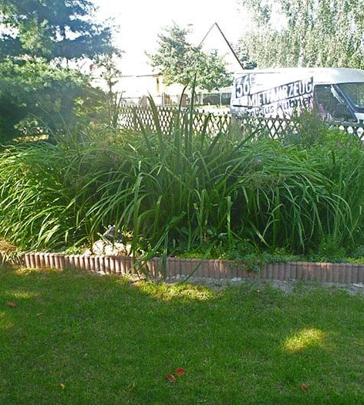
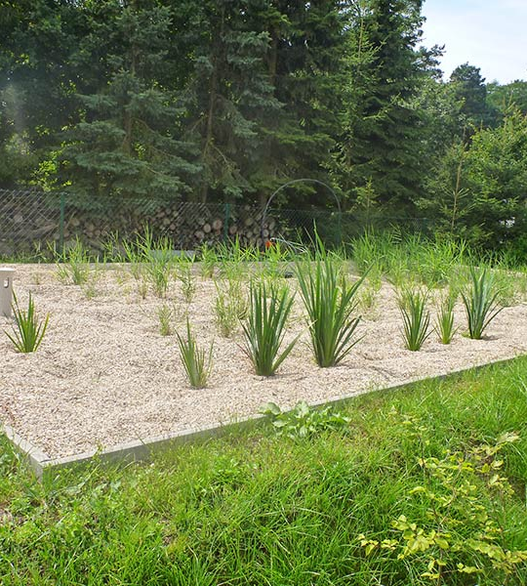
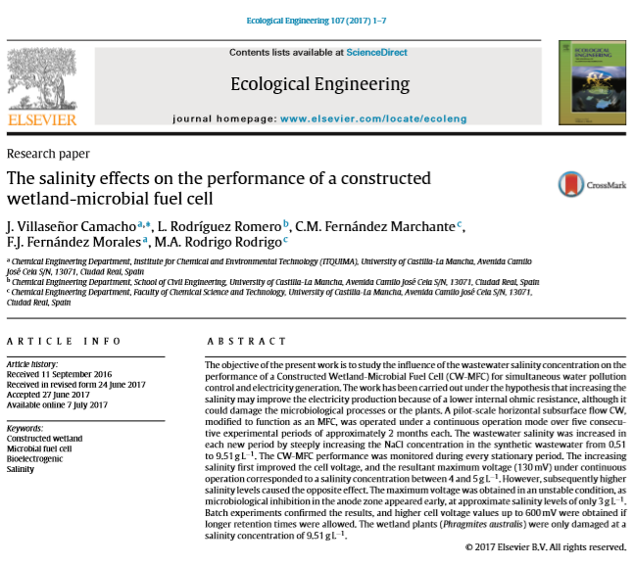
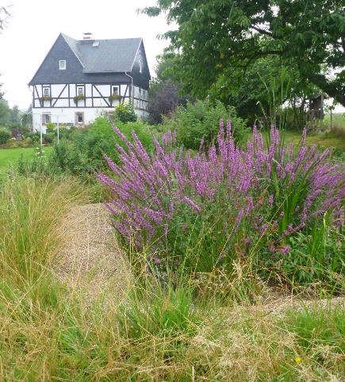
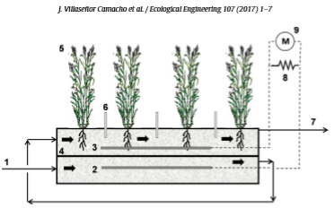
B. Completely new treatment technologies not producing sludge

Slide 16
The pathways towards circular economy: Path C
C
Mechanical treatment
Primary sedimentation
Biological treatment
Secondary sedimentation
Wastewater from the community
Primary sludge
Excess sludge

Slide 17
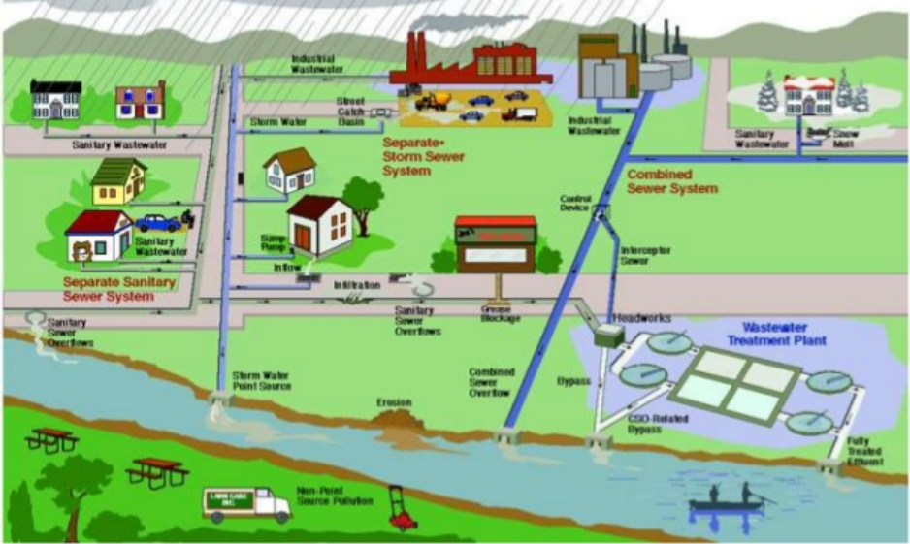
C. Reducing pollutants at source
Total change in societal behavior required:
medicines
hormones
cleaning and washing detergents
Source: https://www.slideshare.net/5032683/lec-1-wastewater-collection-system

Slide 18
What about a combination?
B
C
Primary sedimentation
A
Mechanical treatment
Biological treatment
Secondary sedimentation
Wastewater from the community
Primary sludge
Excess sludge
Typical WWTP
A
A
Source: https://www.pinterest.com.au

Slide 19
From policies to practical implementation
Gathering sufficient knowledge on the functioning of the new circular systems to avoid unwanted consequences
Policies
Practical implementation
COM (2014) 0398. Towards a circular economy: a zero waste programme for Europe
COM (2015) 614. Closing the loop – An EU action plan for the circular economy

Slide 20
Next steps
Application of a systems approach to engineering efforts appears to be necessary:
The upgrade of the available engineering infrastructure as well as any new construction is usually cost-effective. Considering system's dynamics, constrains and conditions before undertaking any actions will minimize financial, social and environmental costs.

