Slide 1
Teaching and Learning Methods in UACEG
Assoc. Prof. Dr. Eng. Petar Filkov
University of Architecture, Civil Engineering and Geodesy, Sofia, Bulgaria
Theme-based Staff Training in UACEG, Sofia/ 29-31.05.2019
This project has been funded with support from the European Commission. This publication reflects the views only of the author, and the Commission cannot be held responsible for any use which may be made of the information contained therein.

Slide 2
Contents
UACEG – Who we are
Classical Teaching Method
Updated Classical Method
Innovative Approach
Future Trends
Strengthening of master curricula in water resources management
for the Western Balkans HEIs and stakeholders

Slide 3
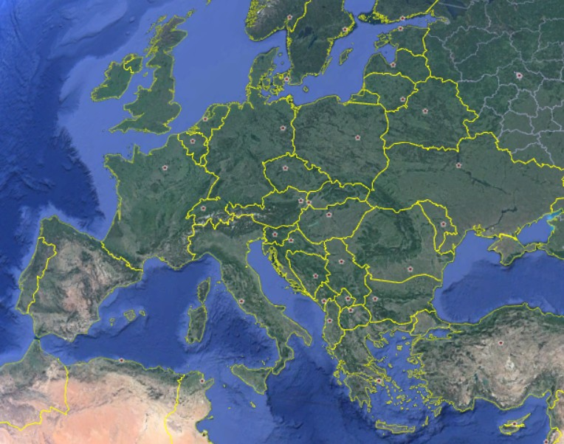
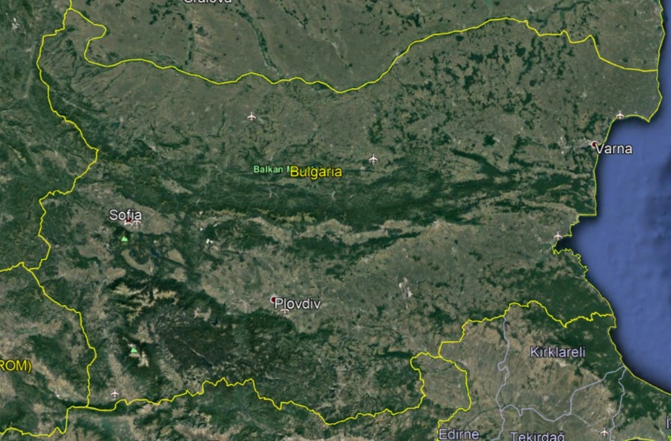
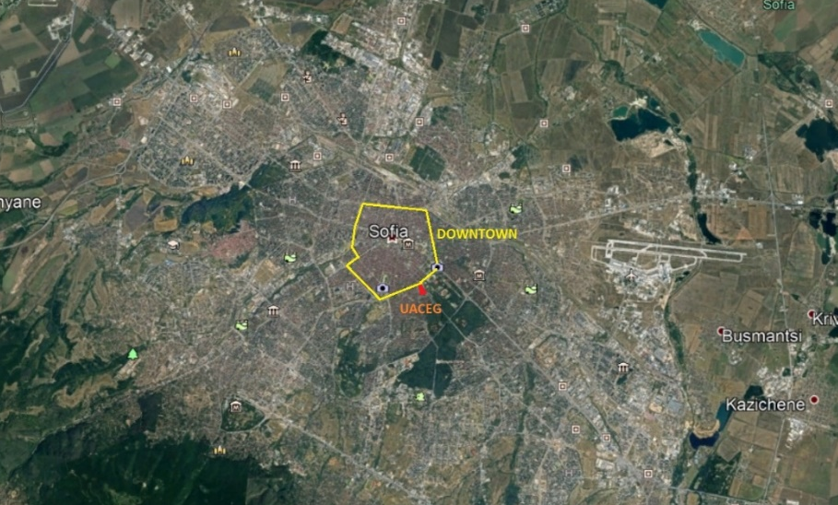
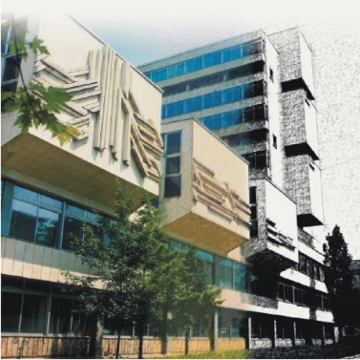
1. UACEG - Location
Europe, Bulgaria,
Sofia, 1 Hr. Smirnenski Blvd
www.uacg.bg
Strengthening of master curricula in water resources management
for the Western Balkans HEIs and stakeholders

Slide 4
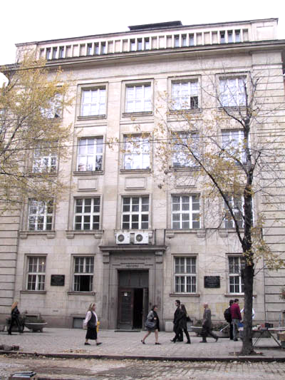
1. UACEG - History
Established in 1942 as a Higher Technical School
1945 – transformed into a State Polytechnic.
1953 - separated as Higher Institute for Architecture and Civil Engineering
1995 - transformed into University of Architecture, Civil Engineering and Geodesy (UACEG) on July 21, 1995 by decision of the National Assembly.
All architects, civil engineers and geodesists in Bulgaria between 1945 and 1995 were educated in UACEG.
Strengthening of master curricula in water resources management
for the Western Balkans HEIs and stakeholders

Slide 5
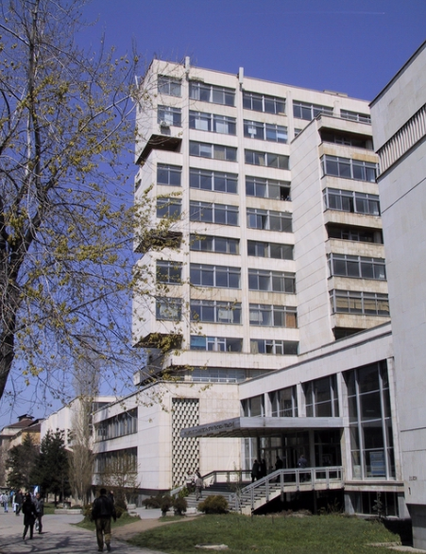
1. UACEG Now
There are 5 faculties at UACEG
Faculty of Architecture
Faculty of Structural Engineering
Faculty of Hydraulic Engineering (FHE)
Faculty of Transportation Engineering
Faculty of Geodesy
The Academic Staff of UACEG:
44 Full Professors
105 Associate Professors
169 Assistant Professors
77 of them have PhD degree
Around 3200 students (2018/2019)
Strengthening of master curricula in water resources management
for the Western Balkans HEIs and stakeholders

Slide 6
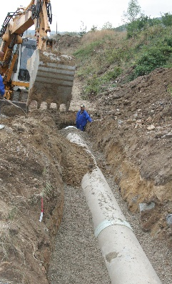
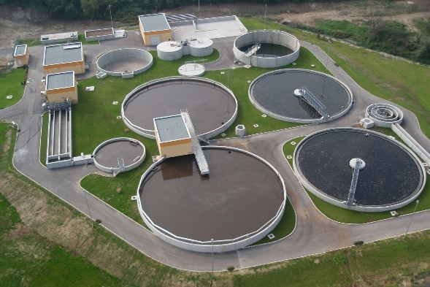
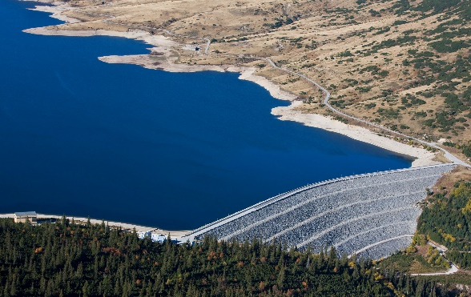
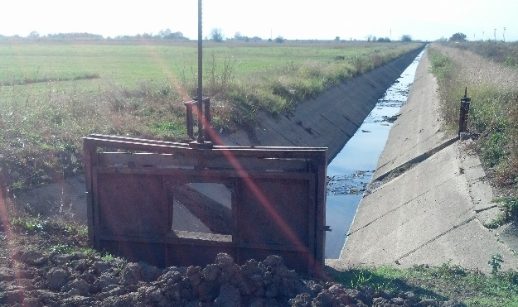
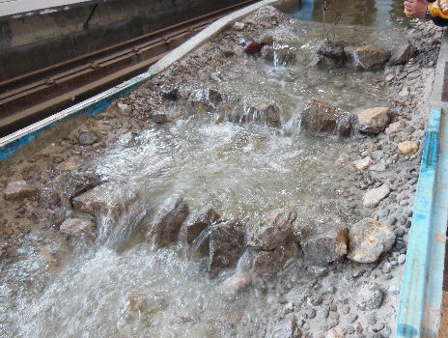
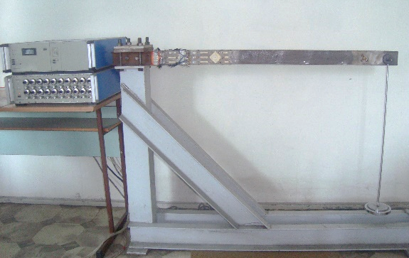
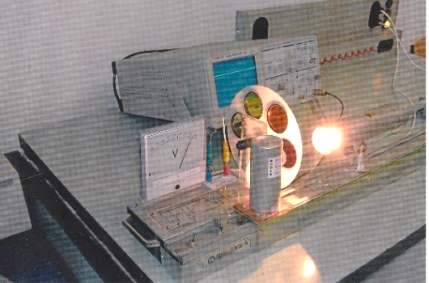
1. UACEG-Faculty of Hydraulic Engineering
Departments
Water Supply, Sewerage, Water and Wastewater Treatment
Hydraulic, Irrigation and Drainage Engineering
Hydraulics and Hydrology
Technical Mechanics
Physics
Academic Staff - 47
8 Full Professors
19 Associate
professors
20 Assistant
professors
Strengthening of master curricula in water resources management
for the Western Balkans HEIs and stakeholders

Slide 7
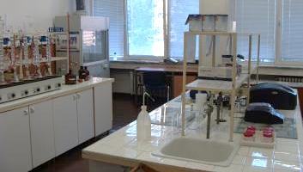
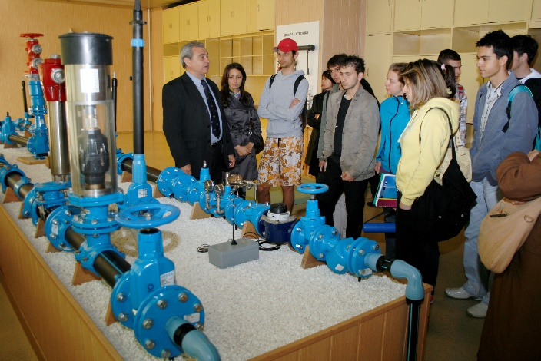
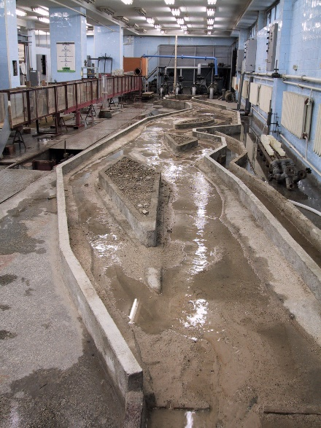
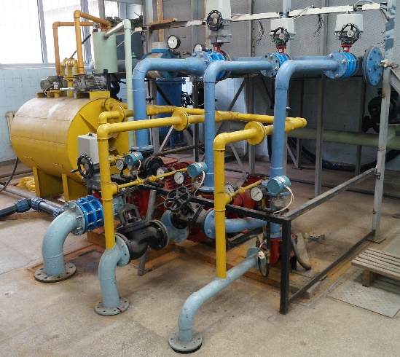
1. UACEG – Labs of FHE
Water Quality Analysis – Accredited Lab
Water Supply and Water Treatment
Water Supply, Sewerage
and Plumbing
(Hawle Demonstration Line)
Irrigation Systems and
Pumping Stations
Drainage Systems
and River Trainings
Hydraulic Structures and HEPP
Central Scientific and Research
Laboratory for Hydraulic Modelling
Strengthening of master curricula in water resources management
for the Western Balkans HEIs and stakeholders

Slide 8
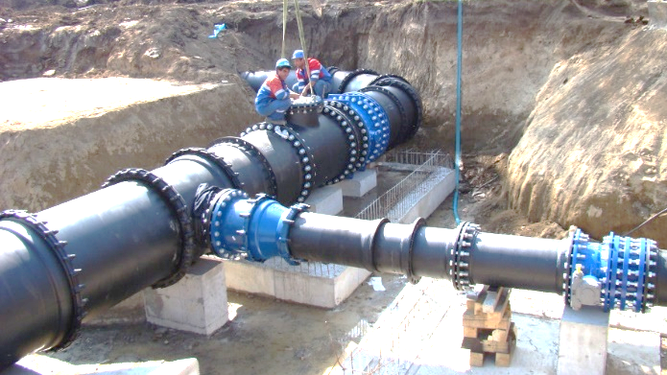
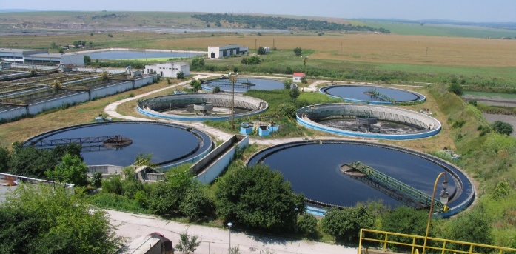
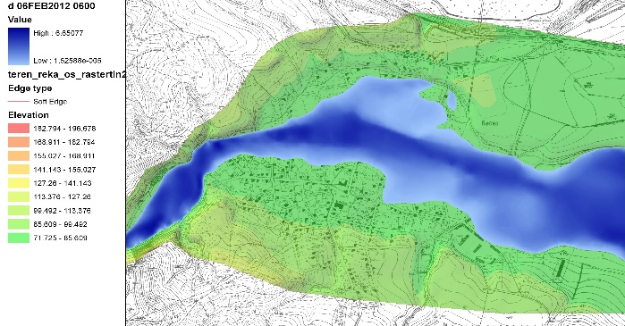
1. UACEG - Study Programs at FHE
Bachelor Degree Programs (4 years)
Engineering Ecology
Integrated Master Degree Programs
(5 years)
Water Supply and Sewerage (WSS)
Water Engineering
Short Master Programs (2 years)
WSS - Systems and Facilities
WSS - Water and Wastewater Treatment
Hydraulic Engineering
Irrigation and Drainage Engineering
Water Маnagement
Gas Supply
Engineering Ecology
Strengthening of master curricula in water resources management
for the Western Balkans HEIs and stakeholders

Slide 9
1. UACEG - Study Programs at FHE
Timeline
2nd year
3rd year
4th year
5th year
Water Supply and Sewerage
(Integrated Master)
Profile „Systems and Facilities“
Profile „Water & Wastewater Treatment“
Water Engineering
(Integrated Master)
Profile „Hydraulic Engineering“
Profile „Irrigation and Drainage Engineering“
Engineering Ecology
(Bachelor Degree)
Short Master Degree Programs
(include mainly subjects from 4th and 5th year)
Strengthening of master curricula in water resources management
for the Western Balkans HEIs and stakeholders

Slide 10
2. Classical Teaching Method
Lectures
Class room
Professor writing on the black/white board,
Students take notes in their notebooks
Still widely used, not only amongst old professors
Strengthening of master curricula in water resources management
for the Western Balkans HEIs and stakeholders

Slide 11
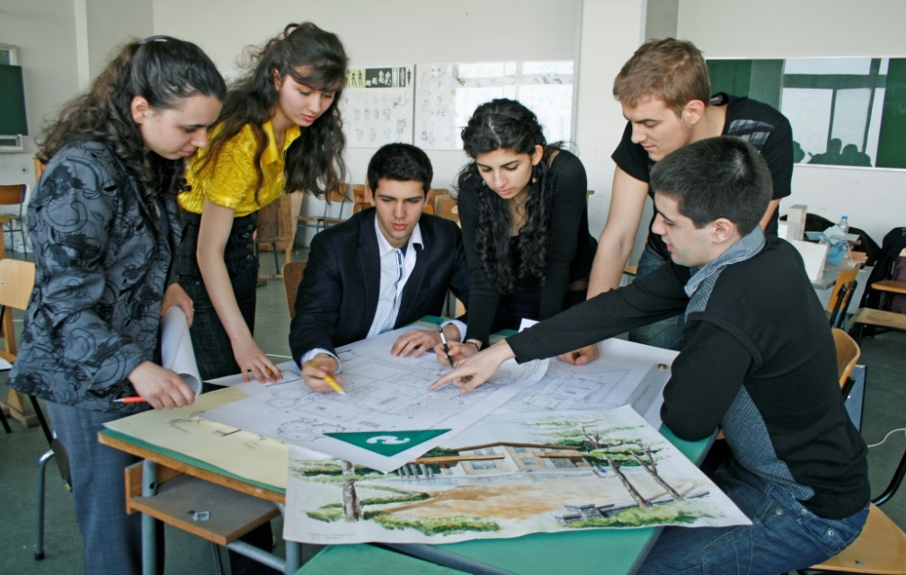
2. Classical Teaching Method
Seminars/Course Project
Class room
Assistant explains how the given task should be solved – approx. 50% of classes (weeks) in the semester
writes on the black/white board;
students take notes
Professor checks the work done – approx. 50% of classes in the semester
Still in use;
young colleagues prefer updated method
Strengthening of master curricula in water resources management
for the Western Balkans HEIs and stakeholders

Slide 12
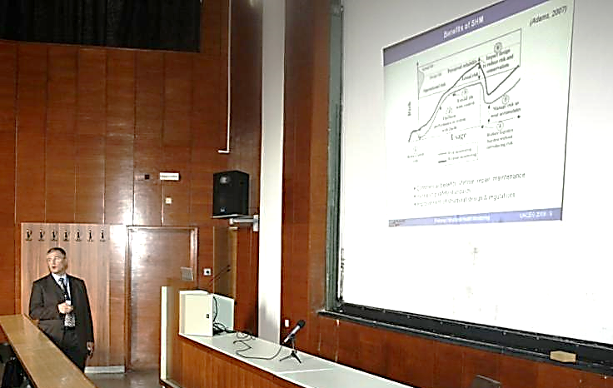
3. Updated Classical Teaching Method
Lectures
Class room
Professor shows PowerPoint presentation using multimedia projector,
Students take notes on the presentation printouts or in notebooks
The most popular method
Strengthening of master curricula in water resources management
for the Western Balkans HEIs and stakeholders

Slide 13
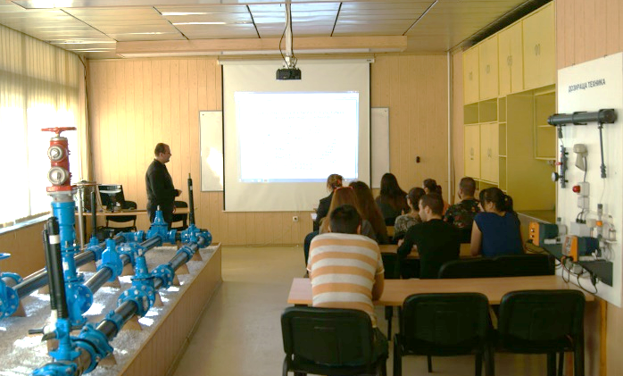
3. Updated Classical Teaching Method
Seminars/Course Project
Class room
Assistant explains how the given task should be solved – approx. 50% of classes (weeks) in the semester
shows PowerPoint presentations (incl. example solved);
students take notes on printouts
Checks of the work done – approx. 50% of classes
Very popular in UACEG
Strengthening of master curricula in water resources management
for the Western Balkans HEIs and stakeholders

Slide 14
4. Innovative Approach
Lectures
Professor assigns themes from syllabus to students (or to groups, consisting of 2-3 students)
Students prepare “their” lecture, in consultations with professor
Students present “their” lecture by means of multimedia projector
Other students take notes
The lecture and presentation are discussed at the end of the class
Strengthening of master curricula in water resources management
for the Western Balkans HEIs and stakeholders

Slide 15
5. Future Trends
Interactive Lectures
Bulgarian Ministry of Education and Science had an Erasmus+ project “Innovative Instruments for Skill Improvement of Higher Education Teachers” for last couple of years.
One of the key recommendations
GO MULTIMEDIA!
GO INTERACTIVE!
The old (classical) teaching methods seem outdated for the “Net-generation”
Strengthening of master curricula in water resources management
for the Western Balkans HEIs and stakeholders

Slide 16
5. Future Trends
Interactive Lectures
“Net-generation” or “5-screens generation” (PC, laptop, smartphone, tablet and phablet screens)
kids get used to work with digital devices
the visual memory is highly developed
the visual information is quickly accepted
the young generations like interactivity, i.e. they are interested in any system that “responds” by a click or a touch of a screen
Strengthening of master curricula in water resources management
for the Western Balkans HEIs and stakeholders

Slide 17
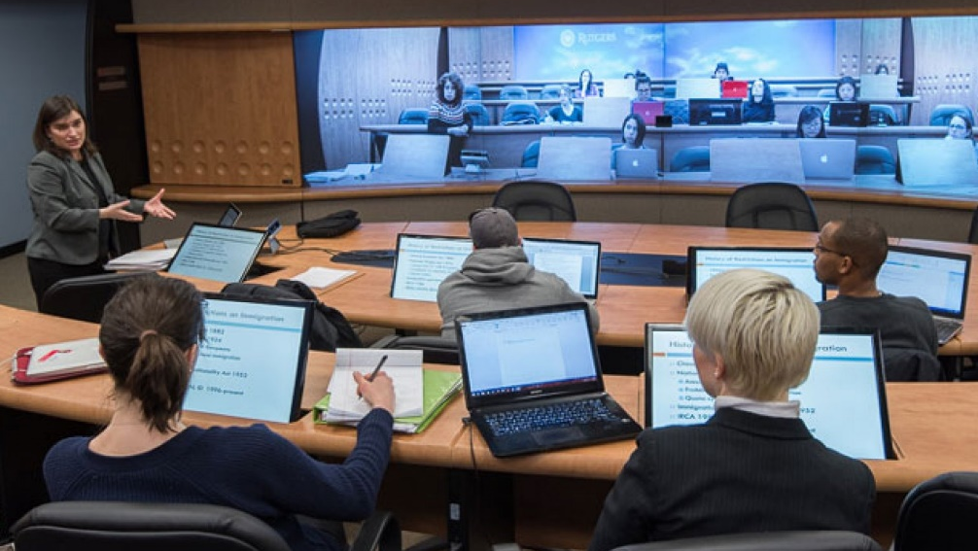
5. Future Trends
Interactive Lectures
Pros
All students can be involved in learning process
Can be used for synchronous distant learning
The lecture can be recorded and used for asynchronous learning
Cons
Need of special devices
Need to develop content
Strengthening of master curricula in water resources management
for the Western Balkans HEIs and stakeholders

Slide 18
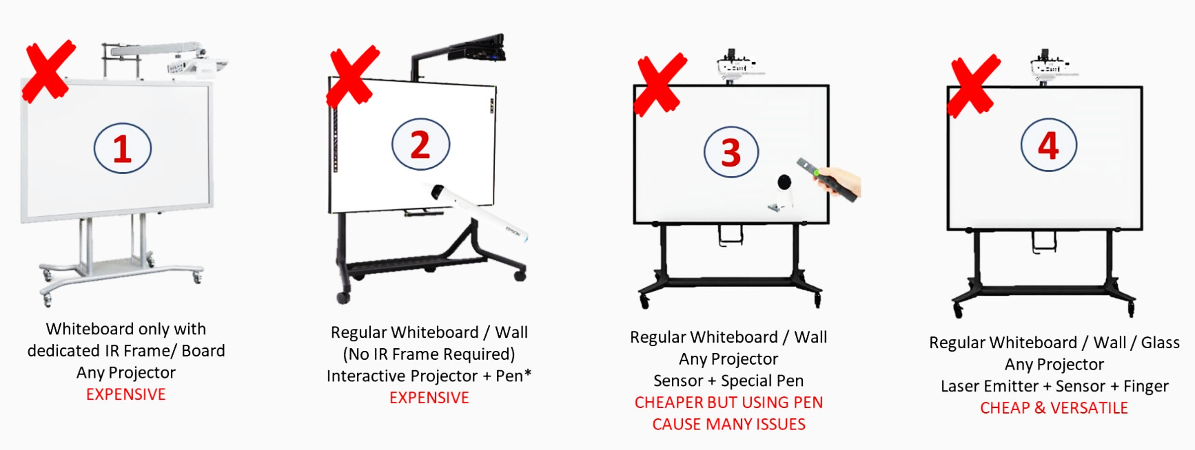
5. Future Trends
Interactive Lectures
Special Multimedia Devices
Strengthening of master curricula in water resources management
for the Western Balkans HEIs and stakeholders

Slide 19
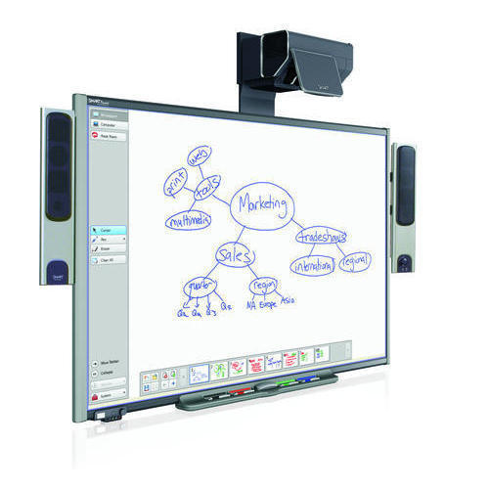
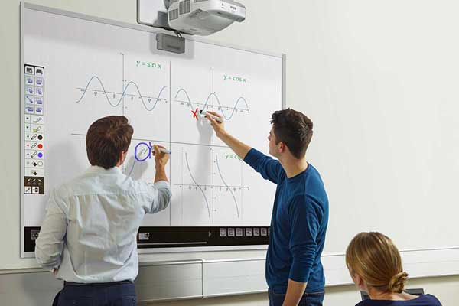
5. Future Trends
Interactive Lectures
Special Multimedia Devices
Short throw projector
Strengthening of master curricula in water resources management
for the Western Balkans HEIs and stakeholders

Slide 20
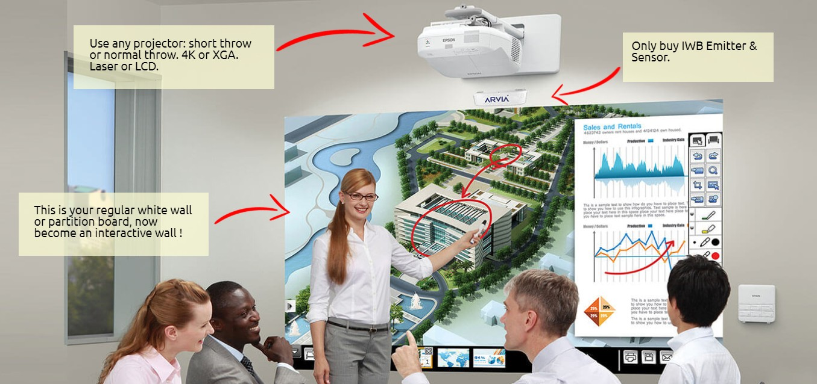
5. Future Trends
Interactive Lectures
Special Multimedia Devices
Strengthening of master curricula in water resources management
for the Western Balkans HEIs and stakeholders

Slide 21
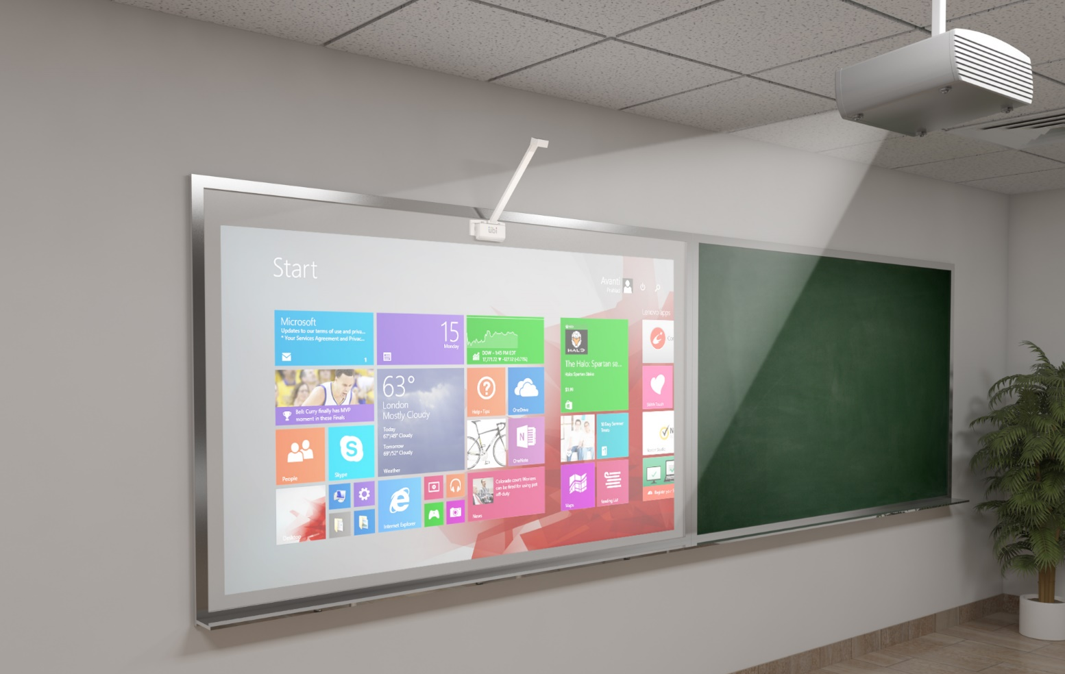
5. Future Trends
Interactive Lectures
Special Multimedia Devices
No need of new PC and projector.
Just new camera, emitter and pen.
Strengthening of master curricula in water resources management
for the Western Balkans HEIs and stakeholders

Slide 22
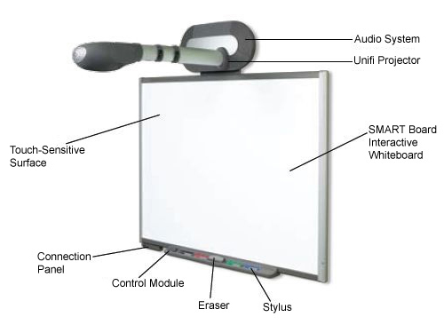
5. Future Trends
Interactive Lectures
Special Multimedia Devices
SMART Board
Strengthening of master curricula in water resources management
for the Western Balkans HEIs and stakeholders

Slide 23
5. Future Trends
Interactive Lectures
Special Multimedia Devices
Whiteboard monitor (touchscreen)
Strengthening of master curricula in water resources management
for the Western Balkans HEIs and stakeholders

Slide 24
5. Future Trends
Interactive Lectures
UACEG has two interactive whiteboards donated this year
One is already installed
Content development is in progress
Strengthening of master curricula in water resources management
for the Western Balkans HEIs and stakeholders

Slide 25
THANK YOU FOR YOUR ATTENTION!
Strengthening of master curricula in water resources management
for the Western Balkans HEIs and stakeholders

