Slide 1
Application of water balances for supporting River Basin Management planning
Assis. Prof. Dr. Eng. Emil Tsanov
University of Architecture, Civil Engineering and Geodesy, Sofia, Bulgaria
Theme-based Staff Training in UACEG
Reflection of the water policies in the education: insights form the Bulgarian experience
Sofia/ 29-31.05.2019
This project has been funded with support from the European Commission. This publication reflects the views only of the author, and the Commission cannot be held responsible for any use which may be made of the information contained therein.

Slide 2

Legislation
Water Framework Directive (WFD) 2000/60/ЕС
  River basins
  Preventive action
  River basin management plans (per 6 years) – include the best combination of measures
  To achieve good status for all water bodies till 2015
  Blueprint to safeguard Europe’s Water Resources
    About half of EU surface waters are unlikely to reach good ecological status in 2015
    Proposing water accounting
  Common implementation strategy
  Water accounting and efficiency objectives at sectorial level
  Guidance Document on the application of water balances for supporting the implementation of the Water Framework Directive (WFD)
  Accounting for future climate change scenarios
  Water balances can also be used as the basis for emergency plans in the case of water shortages
  based on the UN System of Environmental Economic Accounting for Water (SEEA-Water) and its ‘Asset Accounts’
  Based on number of studies- one of them ABOT project
Strengthening of master curricula in water resources management
for the Western Balkans HEIs and stakeholders

Slide 3
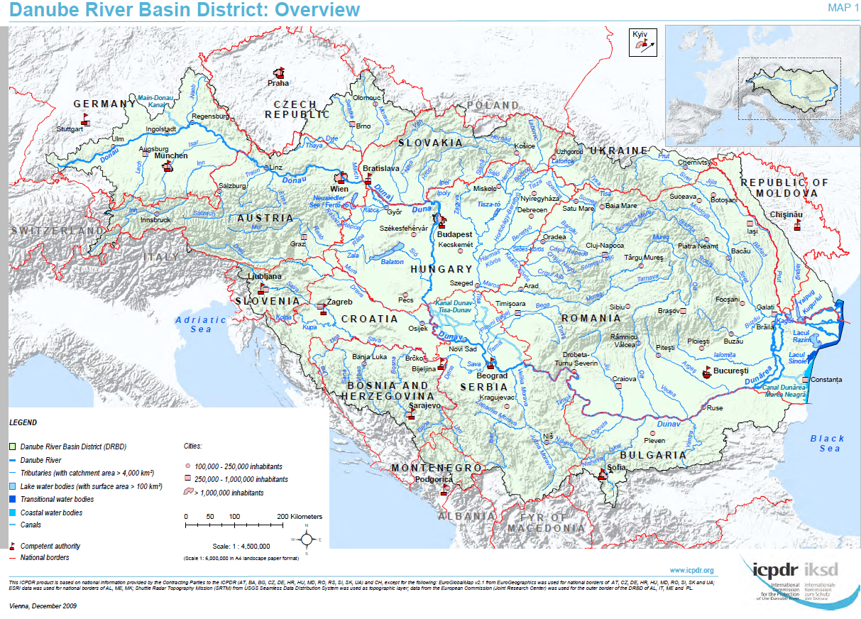
“Assessment of water Balances and Optimisation based Target setting across EU River Basins (ABOT)”
Water balance modeling
in 4 pilot River Basins
across Europe:
Tiber (Italy),
Mulde (Germany),
Ali-Efenti Pinios (Greece),
Vit (Bulgaria)
Strengthening of master curricula in water resources management
for the Western Balkans HEIs and stakeholders

Slide 4
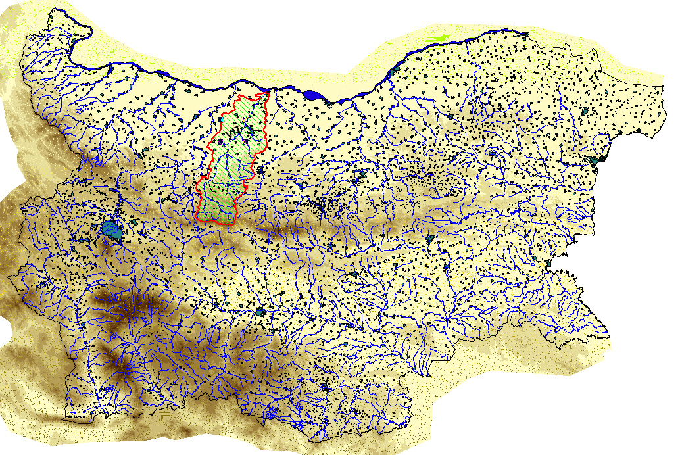
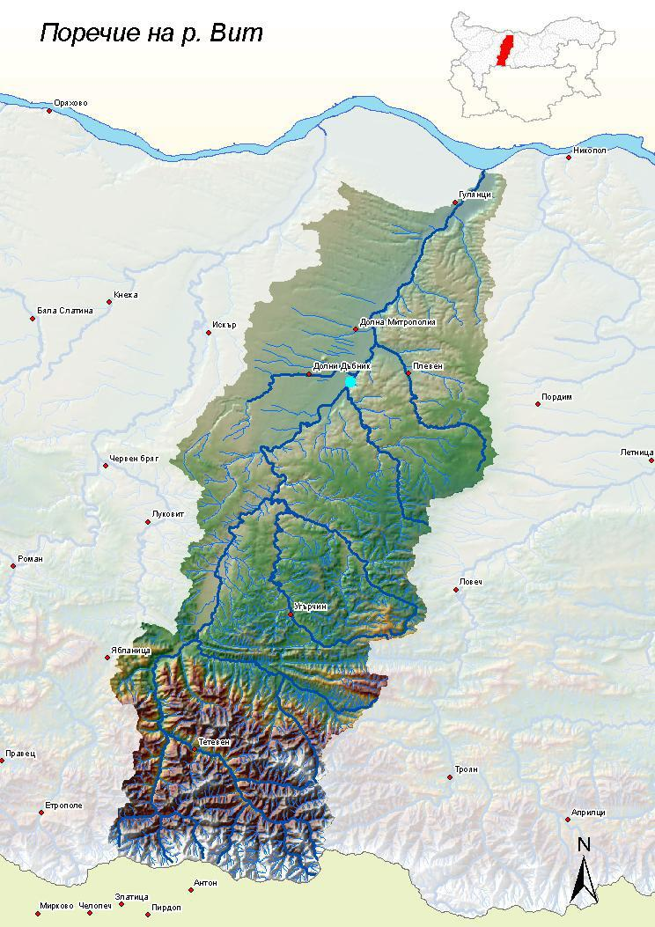
Vit river sub-basin
Vit river sub-basin on the map of Bulgaria
Strengthening of master curricula in water resources management
for the Western Balkans HEIs and stakeholders

Slide 5
Combine approach
Natural-social circle of water
Water users
Households
Industry
Irrigation
Natural water
Surface
Ground
Step 1: Modeling
WEAP
SEEAWater
Step 2: Mitigation measures
Measures by sector
Indicative curves
Step 3: Multi objective optimization
MatLab
Pareto front
Sustainable water management
Scenarios
Decision making
Strengthening of master curricula in water resources management
for the Western Balkans HEIs and stakeholders

Slide 6
Hydrological data
Average monthly river flow at Tarnene station for the period 2000 – 2009 г. (NIMH)
Average monthly precipitation for the period 2000 - 2009 г. (NIMH)
Annual precipitation for the period 2000 – 2009 г. (NIMH)
Strengthening of master curricula in water resources management
for the Western Balkans HEIs and stakeholders

Slide 7
Hydrological data
Monthly precipitation for 2009 (NIMH)
Monthly precipitation for 2011 (NIMH)
Strengthening of master curricula in water resources management
for the Western Balkans HEIs and stakeholders

Slide 8
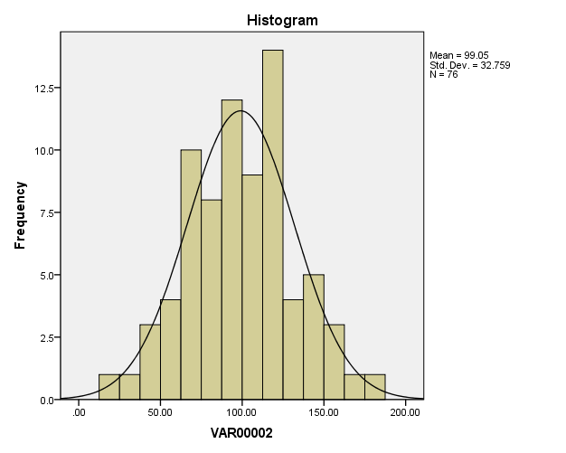
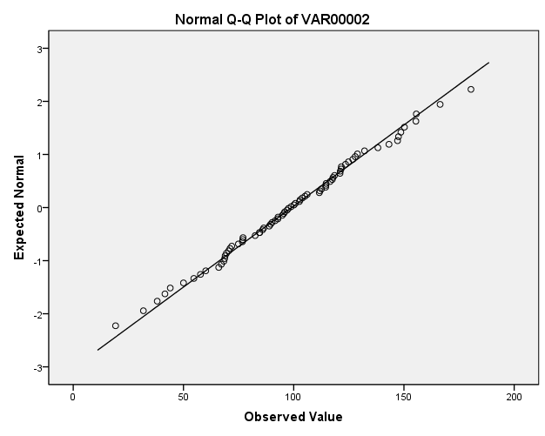
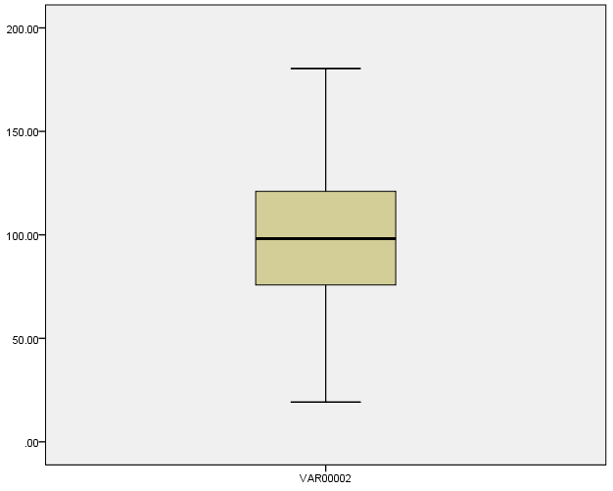
Evaluation of input information
Main statistic parameters
Average |  | 99.0474
95% confidence interval | Lower boundary | 91.5616
 | Upper boundary | 106.5331
Median |  | 98.2000
Standard variation |  | 32.75906
Min |  | 19.20
Max |  | 180.40
Range |  | 161.20
skewness |  | 0.007
kurtosis |  | -0.128
Distribution is normal with value of the null hypothesis Sig(P)=0.995!
Histogram and theoretical curve of normal distribution- accounted water
Normal Q-Q plot – accounted water
Detrended normal Q-Q plot
Strengthening of master curricula in water resources management
for the Western Balkans HEIs and stakeholders

Slide 9
Settlements
Population in Vit river sub-basin (own processing of database from NSI)
General information on supplied and accounted water in Vit river sub-basin (own processing of database from NSI)
Strengthening of master curricula in water resources management
for the Western Balkans HEIs and stakeholders

Slide 10
Modelling
WEAP-Water evaluation and planning
It solves a wide range of problems
It can be applied at the river basin level, several river basins as well as the lower level
Appropriate for analyzing various scenarios of what-if type
Adaptive to farming practices
Suitable for detailed modeling of water demand
WEAP can work as COM Automation Server
Strengthening of master curricula in water resources management
for the Western Balkans HEIs and stakeholders

Slide 11
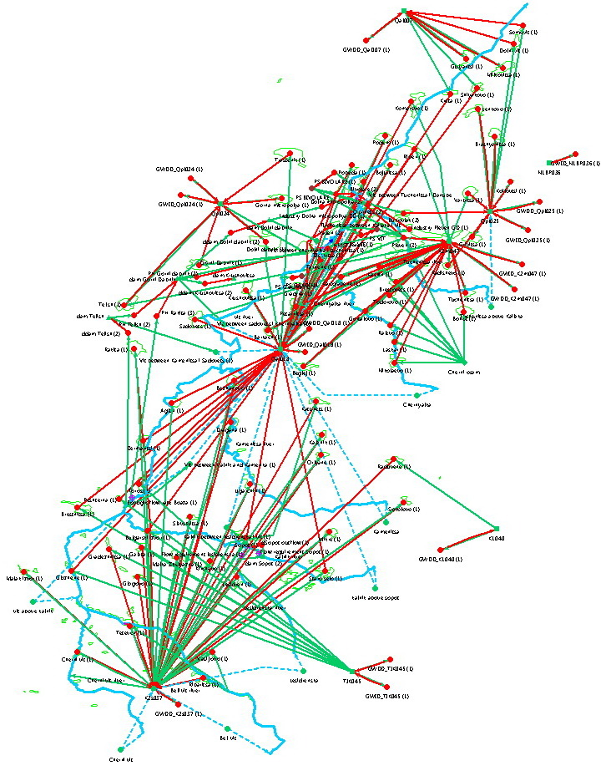
Developing the model structure
15 sub catchments;
104 design nodes:
  77 simulating settlements, of which 47 in Pleven WO and 30 Lovetch WO;
  15 simulating private and public water user using ground water by drills води.
  12 for reservoir management, for PH, industry, WWTP and pumping stations.
5 reservoirs with economic significance
8 simulating ground water bodies
3 controlling minimal river runoff
1 other type water supplier
1 for hydrometric stations at Tarnene
Modeling scheme of Vit river sub-basin
Strengthening of master curricula in water resources management
for the Western Balkans HEIs and stakeholders

Slide 12
Modelling of settlements
Water balance
Input data
Population
Average water use
Water losses (non-revenue water)
Coefficient of monthly variation
Settlement
Strengthening of master curricula in water resources management
for the Western Balkans HEIs and stakeholders

Slide 13
Modelling of sub-catchments
Input data
Rainfall Runoff method
Area
Irrigated and non irrigated areas
Crops
Crop coefficient
Effective precipitation
Precipitation
Irrigation efficiency
Evapotranspiration
Water balance
Sub-catchment
Strengthening of master curricula in water resources management
for the Western Balkans HEIs and stakeholders

Slide 14
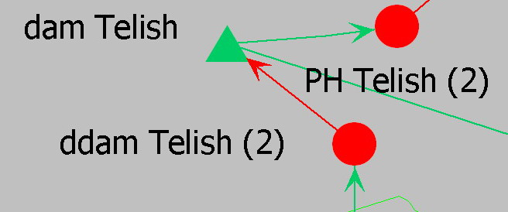
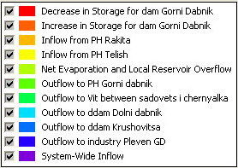
Modelling of reservoirs
Water balance
Input data
Inflow
Total volume
Initial volume
Key curve
Transpiration
Water losses to GWB
Volume
Technical specifications- working volume, dead volume and others.
Reservoir
Strengthening of master curricula in water resources management
for the Western Balkans HEIs and stakeholders

Slide 15
Results
(flow rates at Tarnene HMS)
2009 for calibrating
Annual difference of +2.1%
2011 for validating
Annual difference of -1.77%
Red- observed flow rate
Blue- simulated flow rate
Strengthening of master curricula in water resources management
for the Western Balkans HEIs and stakeholders

Slide 16
Results
(stored water volumes in reservoirs in 2009)
Sopot reservoir- annual diff. of -0.45%
Gorni dabnik reservoir- annual diff.of -5.93%
Telish reservoir- annual diff. of +0.45%
Red- observed flow rate
Blue- simulated flow rate
Strengthening of master curricula in water resources management
for the Western Balkans HEIs and stakeholders

Slide 17
SEEA-Water
Flows from
the environment
to the economy
Inland water resource system and other resources
Flows within
the economy
of which: ISIC div. 36 - Collection, purification and distribution of water
Imports
Exports
Industries
ISIC
Households
ISIC 37 – канализация
Flows from the economy into the
environment
Inland water resource system and other sources
Strengthening of master curricula in water resources management
for the Western Balkans HEIs and stakeholders

Slide 18


Application of SEEA-Water
VIT RIVER
TELISH RESERVOIR
HPP RAKITA
HPP TELISH
IRRIGATION
GORNI DABNIK
RESERVOIR
IRRIGATION
HPP GORNI DABNIK
INDUSTRY
DOLNI DABNIL
RESERVOIR
IRRIGATION
INDUSTRY
PUBLIC WATER SUPPLY
SETTLEMENTS
HOUSHOLDS/PUBLIC
IMPORTED WATER (from
GROUND WATER
other river basin)
SEWERAGE
Abstraction from nature
Return water
Within economy
Within nature
Strengthening of master curricula in water resources management
for the Western Balkans HEIs and stakeholders

Slide 19
 |  |  |  |  |  |  |  | units: million m³
 |  | Industries (by ISIC category) |  |  |  |  |  |  |  | Households | Rest of the world | Total
 |  |  | 5-33, |  |  |  |  | 38,39,
 |  | 1-3 | 41-43 | 35 | 36 |  | 37 | 45-99 | Total
From the environment | 1. Total abstraction(=1.a+1.b = 1.i+1.ii) | 12.66 | 6.02 | 63.87 | 73.40 |  | 0 | 0 | 155.24 | 0.24 |  | 155.49
 | 1.a. Abstraction for own use | 12.66 | 6.02 | 63.87 |  |  |  |  | 81.84 | 0 |  | 81.84
 | 1.b. Abstraction for distribution |  | 0 | 0 | 73.40 |  |  |  | 73.40 | 0 |  | 73.40
 | 1.i. From inland water resources: | 12.66 | 6.02 | 63.87 | 73.40 |  | 0 | 0 | 155.24 | 0.24 |  | 155.49
 | 1.i.1 Surface water | 0 |  | 63.87 | 66.32 |  | 0 |  | 130.19 | 0 |  | 130.19
 | From Vit river to HPP Rakita |  |  |  | 50.39
 | -from reservoirs to industry |  |  |  | 2.65
 | -from reservoirs to irrigation |  |  |  | 13.28
 | -from reservoirs to HPPs |  |  | 63.87
 | 1.i.2 Groundwater | 0.00 | 6.02 | 0.00 | 7.08 |  | 0 | 0 | 13.10 | 0 |  | 13.10
 | For public water supply |  |  |  | 7.08 |  |  |  |  | 0.24
 | For industry |  | 6.02
 | 1.i.3 Soil water | 12.25 | 0 | 0 | 0 |  |  | 0 | 12.25 | 0 |  | 12.25
 | 1.ii. From others: | 0 | 0 | 0 | 0 |  | 0 | 0 | 0.00 |  |  | 0.00
 | 1.ii.1 Collection of precipitation | 0 | 0 | 0 | 0 |  | 0 | 0 | 0.00 | 0
 | 1.ii.2 Abstraction from the sea | 0 | 0 | 0 | 0 |  | 0 | 0 | 0.00 | 0
Within the economy | 2. Use of water received from other economic units | 8.65 | 2.23 | 32.32 | 12.30 |  | 9.99 | 2.39 | 67.56 | 7.00 | 0 | 74.55
 | 2.а. Reused water
 | 2.b. Wastewater to sewerage
3. Total use of water (=1+2) |  | 20.90 | 8.25 | 96.19 | 85.70 |  | 9.99 | 2.39 | 223.5 | 7.24 | 0 | 230.34
Physical use table (according to the model in SEEA-Water)
Strengthening of master curricula in water resources management
for the Western Balkans HEIs and stakeholders

Slide 20
 |  |  |  |  |  |  |  | units: million m³
 |  | Industries (by ISIC category) |  |  |  |  |  |  |  | Households | Rest of the world | Total
 |  |  | 5-33, |  |  |  |  | 38,39,
 |  | 1-3 | 41-43 | 35 | 36 |  | 37 | 45-99 | Total
From the environment | 1. Total abstraction (=1.a+1.b = 1.i+1.ii) | 12.66 | 6.02 | 63.87 | 73.40 |  | 0 | 0 | 155.24 | 0.24 |  | 155.49
 | 1.a. Abstraction for own use | 12.66 | 6.02 | 63.87 |  |  |  |  | 81.84 | 0 |  | 81.84
 | 1.b. Abstraction for distribution |  | 0 | 0 | 73.40 |  |  |  | 73.40 | 0 |  | 73.40
 | 1.i. From inland water resources: | 12.66 | 6.02 | 63.87 | 73.40 |  | 0 | 0 | 155.24 | 0.24 |  | 155.49
 | 1.i.1 Surface water | 0 |  | 63.87 | 66.32 |  | 0 |  | 130.19 | 0 |  | 130.19
 | From Vit river to HPP Rakita |  |  |  | 50.39
 | -from reservoirs to industry |  |  |  | 2.65
 | -from reservoirs to irrigation |  |  |  | 13.28
 | -from reservoirs to HPPs |  |  | 63.87
 | 1.i.2 Groundwater | 0.00 | 6.02 | 0.00 | 7.08 |  | 0 | 0 | 13.10 | 0 |  | 13.10
 | For public water supply |  |  |  | 7.08 |  |  |  |  | 0.24
 | For industry |  | 6.02
 | 1.i.3 Soil water | 12.25 | 0 | 0 | 0 |  |  | 0 | 12.25 | 0 |  | 12.25
 | 1.ii. From others: | 0 | 0 | 0 | 0 |  | 0 | 0 | 0.00 |  |  | 0.00
 | 1.ii.1 Collection of precipitation | 0 | 0 | 0 | 0 |  | 0 | 0 | 0.00 | 0
 | 1.ii.2 Abstraction from the sea | 0 | 0 | 0 | 0 |  | 0 | 0 | 0.00 | 0
Within the economy | 2. Use of water received from other economic units | 8.65 | 2.23 | 32.32 | 12.30 |  | 9.99 | 2.39 | 67.56 | 7.00 | 0 | 74.55
 | 2.а. Reused water
 | 2.b. Wastewater to sewerage
3. Total use of water (=1+2) |  | 20.90 | 8.25 | 96.19 | 85.70 |  | 9.99 | 2.39 | 223.5 | 7.24 | 0 | 230.34
Physical use table (according to the model in SEEA-Water)
Strengthening of master curricula in water resources management
for the Western Balkans HEIs and stakeholders

Slide 21
Advantages of simulating data for filling in the SEEA-Water tables
        Allows simulation and computation of missing data and/or to check credibility of excising data.
        Allows automations of the process of filling in the tables. In this way the room for errors is reduced significantly.
Strengthening of master curricula in water resources management
for the Western Balkans HEIs and stakeholders

Slide 22
Optimization
Multi objective optimization– there is no single solution
Evolutionary algorithms are using
The principal of evolution – reduced computation time
Very good balance between the use of best solutions and the search of space
Create multiple solutions at each computational step
Efficiency
т.В
Area of possible solutions
PF- Pareto front
т.А- non-dominant point
т. В- dominant point
т.С- unexciting point
PF
т.А
т.С
Front Pareto in multi objective optimization
Price
Strengthening of master curricula in water resources management
for the Western Balkans HEIs and stakeholders

Slide 23
Indicative curves
Presents the relationship between the effect of certain measure and investment.
During the development of RBMPs forecast for water demand can be used.
Type of water use | Used water
 | m³/year
Public water supply | 19 394 283
Agriculture | 8 651 636
Industry | 2 231 000
HPP | 147 071 938
The group of measures aim to reduce:
physical losses by the water networks;
inefficient water use by end users.
The development of the indicative curve should be done at lower scale- business plans by water operators, industry, municipalities etc.
Different approach is used to develop the individual curves and shown in next slides.
Strengthening of master curricula in water resources management
for the Western Balkans HEIs and stakeholders

Slide 24
Reducing physical leakages in Pleven
Steps:
1st – Pressure management
2nd – Active leakage control– in 4 steps
3rd – Replace part of the network
Parameters of the complex indicative curve for reducing water losses in the town of Pleven
Measure | Physical leakages reduction on annual basis | Physical losses | Cumulative reduction in losses on an annual basis | Effect on leakage reduction | Investment | Cumulative price
 | m³/year | m³/year | m³/year | % | lv/measure | lv
BAU |  | 4,950,902
Step 1: Pressure management | 495,090 | 4,455,812 | 495,090 | 10% | 280,000 | 280,000
Step 2.1 | 1,336,743 | 3,119,068 | 1,831,834 | 37% | 263,250 | 543,250
Step 2.2 | 2,194,487 | 2,261,324 | 2,689,577 | 54% | 281,250 | 561,250
Step 2.3 | 2,740,324 | 1,715,487 | 3,235,414 | 65% | 299,250 | 579,250
Step 2.4 | 3,084,201 | 1,371,610 | 3,579,292 | 72% | 317,250 | 597,250
Step 3. Network replacing | 1,371,400 |  | 4,950,691 | 82% | 27,349,370 | 28,226,620
Strengthening of master curricula in water resources management
for the Western Balkans HEIs and stakeholders

Slide 25
Improve water use efficiency in Pleven
Индикативни криви
Single indicative curves for water use reduction in the town of Pleven
Reduction of daily water use [Sh., et al., 2009]
Measure | No change of level of comfort |  | Price per capita
 | l/cap/day | % of reduction | lv
Business as usual | 150 | 0 | 0
1st level of retrofit – water fixtures | 120 | 20% | 30-70
2nd level of retrofit- best sanitary appliances and water appliances | 90 | 40% | 200-600
Water reuse- not applied | 75 | 50% | 2400-4000
Strengthening of master curricula in water resources management
for the Western Balkans HEIs and stakeholders

Slide 26
Improve water use efficiency in Pleven
H₁
FLR₁
SLR₁
H₂
FLR₂
SLR₂
2 measures – split the population in 2 groups (H1 и H2). And apply the measure (2) for each group. Total of 6 variables
Computational scheme for the development of complex indicative curve for water use reduction in the town of Pleven
Complex indicative curve for water use reduction in the town of Pleven (results from optimization by Matlab)
Strengthening of master curricula in water resources management
for the Western Balkans HEIs and stakeholders

Slide 27
Improve irrigation efficiency
Percentage distribution of irrigation crops by type of irrigation system for 2009 (according to data by Irrigation company)
Type of crops | N | Drip | Sprinkler | Furrow | Sum | Percent of totally irrigated areas
 |  | % | % | % | %
Vegetables/ strawberries | 1 | 0.9 | 90.9 | 8.2 | 100 | 67.9
Maize/ sunflower | 2 | 0.0 | 22.3 | 77.7 | 100 | 14.9
Melon | 3 | 0.4 | 69.3 | 30.3 | 100 | 13.3
Fruits | 4 | 55.6 | 0.0 | 44.4 | 100 | 0.3
Tabaco |  | 0.0 | 0.0 | 100.0 | 100 | 3.6
 |  |  |  |  | Σ | 100.0
Type of crops | Площи |  |  |  | Coefficient of efficiency
 | Drip | Sprinkler | Furrow | Sum
 | ha | ha | ha | ha | Drip | Sprinkler | Furrow | Weighted average
Vegetables/ strawberries | 1.1 | 117.6 | 10.643 | 129.34 | 0.94 | 0.79 | 0.65 | 0.780
Maize/ sunflower | 0 | 6.3 | 21.995 | 28.295 | 0.94 | 0.79 | 0.65 | 0.681
Melon | 0.1 | 17.575 | 7.7 | 25.375 | 0.94 | 0.79 | 0.65 | 0.748
Fruits | 0.3 | 0 | 0.24 | 0.54 | 0.94 | 0.79 | 0.65 | 0.811
Tabaco | 0 | 0 | 6.8 | 6.8 | 0.94 | 0.79 | 0.65 | 0.650
 |  |  | Σ | 190.35 |  | Weighted average = |  | 0.756
Strengthening of master curricula in water resources management
for the Western Balkans HEIs and stakeholders

Slide 28
Improving irrigation efficiency
Computation scheme for developing indicative curve for improving irrigation efficiency
Each arrow represents variables in the optimization process
Objectives:
Improving irrigation efficiency
To reduce water demand
Minimal investment
Reducing effectively irrigated area
The results are Z1 – Z12, representing areas of different crops and irrigation type
Strengthening of master curricula in water resources management
for the Western Balkans HEIs and stakeholders

Slide 29
Improving irrigation efficiency
Indicative curve for improving irrigation efficiency (results from optimization in Matlab)
Relationship between coefficient of efficiency and effectively irrigated area (results from optimization in Matlab)
Strengthening of master curricula in water resources management
for the Western Balkans HEIs and stakeholders

Slide 30
Simultaneous calculations in WEAP and Matlab
Applying measures
Exporting results from WEAP
Computation of objective function
Stopping criteria
Satisfied?
Generating new sets of values for variables in Toolbox (MATLAB)
Variables
Legend
WEAP21
No
MATLAB
Yes
External files
Pareto front
Strengthening of master curricula in water resources management
for the Western Balkans HEIs and stakeholders

Slide 31
Optimization process in Matlab
Indicative curves
Start
Initial population
Evaluation of individuals
Variables- external files
WEAP - Effect
Selection
Crossover and Mutation
Applying the measures in WEAP
Script in Matlab
Evaluation of individuals
Exporting the results from WEAP to external files
Generating new population
Stopping criterion
No
Result
Yes
Result (Pareto Front)
Strengthening of master curricula in water resources management
for the Western Balkans HEIs and stakeholders

Slide 32
Optimization results for 2009
Population size of 60. Results after 102 generations and computational time of 15 hours.
Pareto Front for Vit river sub-basin for 2009 (results from optimization in Matlab)
Relationship between values of the optimization variables (measures) and abstracted water for 2009 (results from optimization in Matlab)
Strengthening of master curricula in water resources management
for the Western Balkans HEIs and stakeholders

Slide 33
Optimization results for 2011
Population size of 60. Results after 102 generations and computational time of 15 hours.
Pareto Front for Vit river sub-basin for 2011 (results from optimization in Matlab)
Relationship between values of the optimization variables (measures) and abstracted water for 2009 (results from optimization in Matlab)
Strengthening of master curricula in water resources management
for the Western Balkans HEIs and stakeholders

Slide 34
Scenarios
Climate change- increase in evapotranspiration and reduction in precipitation
Economic – increase in irrigated areas
Combined- moderate combination between climate change and economic scenarios
  10% reduction in precipitation
  10% increase in evapotranspiration
  Increase in irrigated areas 10 times
Irrigated areas (designed and current), according to data by Irrigation company
Strengthening of master curricula in water resources management
for the Western Balkans HEIs and stakeholders

Slide 35
Combined scenarios
Simulated abstracted water is 487 mill.m³/year
Compare with 143 mill.m³/year in the reference 2009
Unmet demand for Vit river sub-basin
The unmet demand occur for water user supplied by Gorni dabnik and Dolni dabnik reservoirs. These are irrigated fields and indrustrial areas in the towns of Pleven and Dolna mitropolia.
Strengthening of master curricula in water resources management
for the Western Balkans HEIs and stakeholders

Slide 36
Optimization results for combined scenario
Pareto Front for Vit river sub-basin for combined scenario (results from optimization in Matlab)
Relationship between values of the optimization variables (measures) and abstracted water for combined scenario (results from optimization in Matlab)
Strengthening of master curricula in water resources management
for the Western Balkans HEIs and stakeholders

Slide 37
THANK YOU FOR YOUR ATTENTION!
Strengthening of master curricula in water resources management
for the Western Balkans HEIs and stakeholders

